Slide 1
AJAX and JQUERY
Course Code: CSC 3222
Course Title: Web Technologies
Dept. of Computer Science
Faculty of Science and Technology
Lecturer No: | 12 | Week No: | 12 | Semester: | Fall 2024-2025
Lecturer: | MD.AL-AMIN (alamin@aiub.edu)

Slide 2
Lecture Outline
Introduction to AJAX
AJAX Request and Response
Access JSON using AJAX
Introduction to jQuery
jQuery Selectors
jQuery Events

Slide 3
Introduction to AJAX
What is AJAX
AJAX = Asynchronous JavaScript And XML.
AJAX is not a programming language.
AJAX is a technique for accessing web servers from a web page.
A browser built-in XMLHttpRequest object to request data from a web server
Read data from a web server - after the page has loaded
Update a web page without reloading the page
Send data to a web server - in the background
JavaScript and HTML DOM to display or use the data

Slide 4
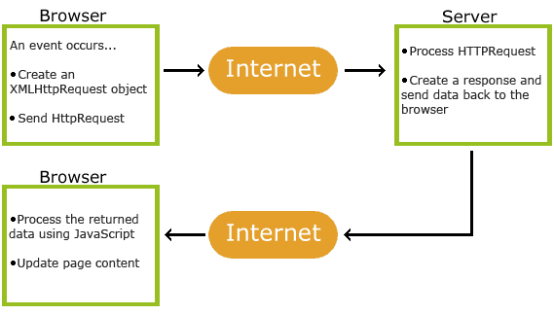
How AJAX Works
1. An event occurs in a web page when the page is loaded, a button is clicked
2. An XMLHttpRequest object is created by JavaScript
3. The XMLHttpRequest object sends a request to a web server
4. The server processes the request
5. The server sends a response back to the web page
6. The response is read by JavaScript
7. Proper action like page update is performed by JavaScript

Slide 5
Example
The HTML page contains a <div> section and a <button>.
The <div> section is used to display information from a server.
The <button> calls a function loadDoc().
The function requests data from a web server and displays it.
function loadDoc() { var xhttp = new XMLHttpRequest(); xhttp.onreadystatechange = function() { if (this.readyState == 4 && this.status == 200) { document.getElementById("demo").innerHTML = this.responseText; } }; xhttp.open("GET", "ajax_info.txt", true); xhttp.send(); }

Slide 6
The XMLHttpRequest Object
The keystone of AJAX is the XMLHttpRequest object.
The XMLHttpRequest object can be used to exchange data with a web server behind the scenes.
it is possible to update parts of a web page, without reloading the whole page.
Syntax for creating an XMLHttpRequest object:
[Variable] = new XMLHttpRequest();
var xhttp = new XMLHttpRequest();

Slide 7
XMLHttpRequest Object Methods
Method | Description
new XMLHttpRequest() | Creates a new XMLHttpRequest object
abort() | Cancels the current request
getAllResponseHeaders() | Returns header information
getResponseHeader() | Returns specific header information
open(method, url, async, user, psw) | Specifies the request method: the request type GET or POST url: the file location async: true (asynchronous) or false (synchronous) user: optional user name psw: optional password
send() | Sends the request to the server Used for GET requests
send(string) | Sends the request to the server. Used for POST requests
setRequestHeader() | Adds a label/value pair to the header to be sent

Slide 8
XMLHttpRequest Object Properties
Property | Description
onreadystatechange | Defines a function to be called when the readyState property changes
readyState | Holds the status of the XMLHttpRequest. 0: request not initialized 1: server connection established 2: request received 3: processing request 4: request finished and response is ready
responseText | Returns the response data as a string
responseXML | Returns the response data as XML data
status | Returns the status-number of a request 200: "OK" 403: "Forbidden" 404: "Not Found" For a complete list go to the Http Messages Reference
statusText | Returns the status-text (e.g. "OK" or "Not Found")

Slide 9
AJAX Request
To send a request to a server, open() and send() methods of the XMLHttpRequest object
xhttp.open("GET", "ajax_info.txt", true);
xhttp.send();
Method | Description
open(method, url, async) | Specifies the type of request method: the type of request: GET or POST url: the server (file) location async: true (asynchronous) or false (synchronous)
send() | Sends the request to the server (used for GET)
send(string) | Sends the request to the server (used for POST)

Slide 10
GET Requests
simple GET request:
xhttp.open("GET", "demo_get.asp", true);
xhttp.send();
To get some specific data using GET method, need to use below example
Example 1:
xhttp.open("GET", "demo_get.asp?t=" + Math.random(), true);
xhttp.send();
Example 2:
xhttp.open("GET", "demo_get2.asp?fname=Henry&lname=Ford", true); xhttp.send();

Slide 11
POST Requests
simple POST request
xhttp.open("POST", "demo_post.asp", true);
xhttp.send();
To POST data like an HTML form, add an HTTP header with setRequestHeader().
To get specific data using POST method need to use
xhttp.open("POST", "ajax_test.asp", true); xhttp.setRequestHeader("Content-type", "application/x-www-form-urlencoded"); xhttp.send("fname=Henry&lname=Ford");
Method | Description
setRequestHeader(header, value) | Adds HTTP headers to the request header: specifies the header name value: specifies the header value

Slide 12
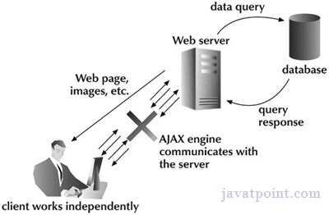
Asynchronous Requests
Server requests should be sent asynchronously.The async parameter of the open() method should be set to true:
xhttp.open("GET", "ajax_test.asp", true);
By sending asynchronously, the JavaScript does not have to wait for the server response.
execute other scripts while waiting for server response
deal with the response after the response is ready

Slide 13
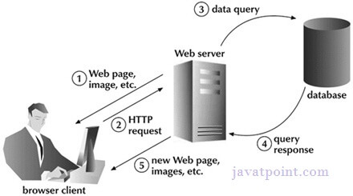
Synchronous Requests
A synchronous request blocks the client until operation completes i.e. browser is unresponsive.
To execute a synchronous request, change the third parameter in the open() method to false:
xhttp.open("GET", "ajax_info.txt", false);
Sometimes async = false are used for quick testing.

Slide 14
AJAX Response
The readyState property holds the status of the XMLHttpRequest.
The onreadystatechange property defines a function to be executed when the readyState changes.
The status property and the statusText property holds the status of the XMLHttpRequest object.
The onreadystatechange function is called every time the readyState changes.
When readyState is 4 and status is 200, the response is ready:
function loadDoc() { var xhttp = new XMLHttpRequest(); xhttp.onreadystatechange = function() { if (this.readyState == 4 && this.status == 200) { document.getElementById("demo").innerHTML = this.responseText; } }; xhttp.open("GET", "ajax_info.txt", true); xhttp.send(); }

Slide 15
AJAX Response
Server Response Methods
Method | Description
getResponseHeader() | Returns specific header information from the server resource
getAllResponseHeaders() | Returns all the header information from the server resource
Server Response Properties
Property | Description
responseText | get the response data as a JS string
responseXML | get the response data as XML Object

Slide 16
Introduction to JSON
JSON: JavaScript Object Notation.
JSON is a syntax for storing and exchanging data.
JSON is text, written with JavaScript object notation.
Sending Data
var myObj = {name: "John", age: 31, city: "New York"};
var myJSON = JSON.stringify(myObj);
window.location = "demo_json.php?x=" + myJSON;
Receiving Data
var myJSON = '{"name":"John", "age":31, "city":"New York"}';
var myObj = JSON.parse(myJSON);
document.getElementById("demo").innerHTML = myObj.name;

Slide 17
JSON with AJAX
<script>
var xmlhttp = new XMLHttpRequest(); xmlhttp.onreadystatechange = function() { if (this.readyState == 4 && this.status == 200) { var myArr = JSON.parse(this.responseText); myFunction(myArr); } }; xmlhttp.open("GET", myTutorials.txt, true); xmlhttp.send(); function myFunction(arr) { var out = ""; var i; for(i = 0; i < arr.length; i++) { out += '<a href="' + arr[i].url + '">' + arr[i].display + '</a><br>'; } document.getElementById("id01").innerHTML = out; }
</script>

Slide 18
Example of JSON
myTutorials.txt
[ { "display": "JavaScript Tutorial", "url": "https://www.w3schools.com/js/default.asp" }, { "display": "HTML Tutorial", "url": "https://www.w3schools.com/html/default.asp" }, { "display": "CSS Tutorial", "url": "https://www.w3schools.com/css/default.asp" } ]

Slide 19
Introduction to jQuery
What is jQuery?
The purpose of jQuery is to make it much easier to use JavaScript.
jQuery is a lightweight JavaScript library.
jQuery takes a lot of common tasks that require many lines of JavaScript code to accomplish and wraps them into methods that you can call with a single line of code.
jQuery also simplifies a lot of the complicated things from JavaScript, like AJAX calls and DOM manipulation.

Slide 20
jQuery
The jQuery library contains the following features:
HTML/DOM manipulation
CSS manipulation
HTML event methods
Effects and animations
AJAX
Utilities
There are lots of other JavaScript libraries out there but jQuery is probably the most popular, and also the most extendable.
Many of the biggest companies on the Web use jQuery, such as:
Google
Microsoft
IBM
Netflix

Slide 21
Example
The jQuery syntax is tailor-made for selecting HTML elements and performing some action on the element(s).
$(selector).action()
A $ sign to define/access jQuery
A (selector) to "query (or find)" HTML elements
A jQuery action() to be performed on the element(s)
$(this).hide() - hides the current element.
$("p").hide() - hides all <p> elements.
$(".test").hide() - hides all elements with class="test".
$("#test").hide() - hides the element with id="test".

Slide 22
jQuery Selectors
jQuery selectors allow you to select and manipulate HTML element(s).
jQuery selectors are used to "find" (or select) HTML elements based on their name, id, classes, types, attributes, values of attributes and much more. It's based on the existing CSS Selectors
it has some own custom selectors.
All selectors in jQuery start with the dollar sign and parentheses: $().

Slide 23
The element Selector
The jQuery element selector selects elements based on the element name.
To select all <p> elements on a page $("p")
Example
$(document).ready(function(){
$("button").click(function(){
$("p").hide();
});
});
When a user clicks on a button, all <p> elements will be hidden:

Slide 24
The #id Selector
jQuery #id selector uses the id attribute of an HTML tag to find the specific element.
An id should be unique within a page, so you should use the #id selector when you want to find a single, unique element.
To find an element with a specific id, write a hash character, followed by the id of the HTML element $("#test")
$(document).ready(function(){
$("button").click(function(){
$("#test").hide();
});
});
When a user clicks on a button, the element with id="test" will be hidden.

Slide 25
The .class Selector
jQuery #id selector uses the id attribute of an HTML tag to find the specific element.
An id should be unique within a page, so you should use the #id selector when you want to find a single, unique element.
To find an element with a specific id, write a hash character, followed by the id of the HTML element $("#test")
$(document).ready(function(){
$("button").click(function(){
$("#test").hide();
});
});
When a user clicks on a button, the element with id="test" will be hidden.

Slide 26
The .class Selector
The jQuery .class selector finds elements with a specific class.
To find elements with a specific class, write a period character, followed by the name of the class $(".test")
Example
$(document).ready(function(){
$("button").click(function(){
$(".test").hide();
});
});
When a user clicks on a button, the elements with class="test" will be hidden:

Slide 27
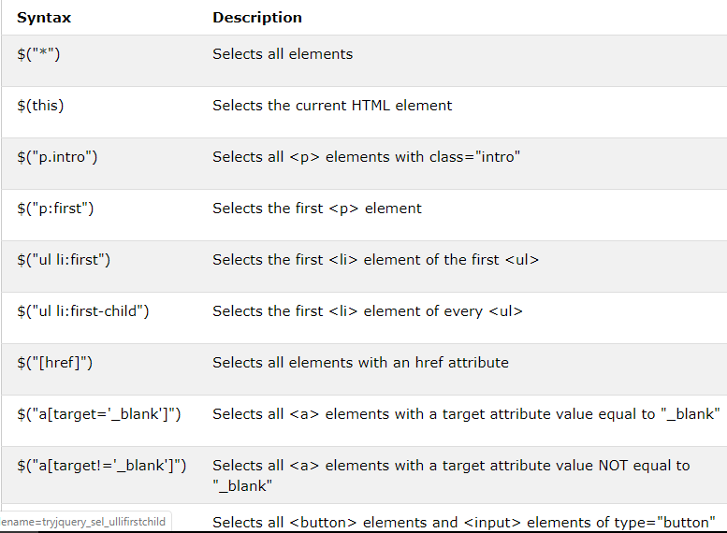

Slide 28
jQuery Event Methods
All the different visitors' actions that a web page can respond to are called events.
An event represents the precise moment when something happens.
Examples:
moving a mouse over an element
selecting a radio button
clicking on an element
The term "fires/fired" is often used with events. Example: "The keypress event is fired, the moment you press a key".

Slide 29
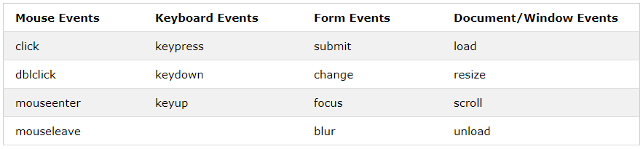
jQuery Event Methods
some common DOM events

Slide 30
click()
The click() method attaches an event handler function to an HTML element.
The function is executed when the user clicks on the HTML element.
The following example says: When a click event fires on a <p> element; hide the current <p> element
$(document).ready(function(){
$("p").click(function(){
$(this).hide();
});
});
dblclick()
The dblclick() method attaches an event handler function to an HTML element.
The function is executed when the user double-clicks on the HTML element
$(document).ready(function(){
$("p").dblclick(function(){
$(this).hide();
});
});

Slide 31
mouseenter()
The mouseenter() method attaches an event handler function to an HTML element.
The function is executed when the mouse pointer enters the HTML element
$(document).ready(function(){
$("#p1").mouseenter(function(){
alert("You entered p1!");
});
});
mouseleave()
The mouseleave() method attaches an event handler function to an HTML element.
The function is executed when the mouse pointer leaves the HTML element
$(document).ready(function(){
$("#p1").mouseleave(function(){
alert("Bye! You now leave p1!");
});
});

Slide 32
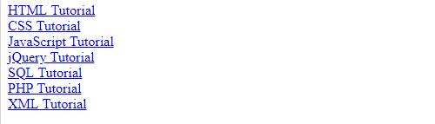
Output

Slide 33
References
MySQL - www.mysql.com
W3Schools Online Web Tutorials- www.w3schools.com
PHP Manual - www.php.net
Free Online Tutorials - www.javatpoint.com

Slide 34
Books
Sams Teach Yourself Ajax JavaScript and PHP All in One; Phil Ballard and Michael Moncur;
Sams Publishing; 2010
JavaScript Phrasebook; Christian Wenz; Sams Publishing; 2007
PHP and MySQL Web Development, 4/E; Luke Welling and Laura Thomson; AddisonWesley Professional; 2009
JavaScript for Programmers Paul J. Deitel and Harvey M. Deitel; Prentice Hall; 2009

